Slide 1
Cloud-Enable an ASP.NET MVC LOB App
Bret Stateham | Sr. Technical Evangelist
Christopher Harrison | Content Developer

Slide 2

Meet Bret Stateham | ‏@BretStateham
Senior Technical Evangelist, Microsoft
Been working with Azure since the beginning
Been playing around with IoT lately
Love seeing how Azure really fits in to just about any workload
Find my blog at http://BretStateham.com

Slide 3

Meet Christopher Harrison | ‏@geektrainer
Content Developer
Focused on ASP.NET and Office 365 development
Microsoft Certified Trainer
Regular presenter at TechEd
Long time geek
Still misses his Commodore 64
Periodic blogger (blog.geektrainer.com)
Marathoner, husband, father of one four legged child

Slide 4
Course Topics
Cloud-Enable an ASP.NET MVC LOB App
01 | Overview
02 | Moving data to the cloud
03 | Moving services to the cloud
04 | Securing cloud services
05 | Integrating and Extending Cloud Services

Slide 5
Setting Expectations
Target Audience
Enterprise Developers working with ASP.NET MVC
Looking to leverage Microsoft Azure
Suggested Prerequisites
Understanding of ASP.NET MVC
Understanding of SQL Databases
Understanding of WCF Services

Slide 6
Join the MVA Community!
Microsoft Virtual Academy
Free online learning tailored for IT Pros and Developers
Over 2M registered users
Up-to-date, relevant training on variety of Microsoft products
“Earn while you learn!”
Get 50 MVA Points for this event!
Visit http://aka.ms/MVA-Voucher
Enter this code: ASPMVCAppsToCloud (expires 03/16/2015)

Slide 7
01 | Overview
Bret Stateham | Sr. Technical Evangelist
Christopher Harrison | Content Developer

Slide 8
Azure Overview
Azure Overview
Expenses App Scenario Introduction

Slide 9
Azure Overview

Slide 10
Why Azure?
Rapidly set up environments to drive business priorities
Scale to meet peak demands
Increase daily activities & efficiency while reducing costs
Speed
Scale
Economics
Notes:
Microsoft Azure provides speed, scale, and economic incentives. Everything is self-service.

Slide 11
Solution models
Hosting models
Business model
On Premises
Infrastructure
(as a Service)
Platform
(as a Service)
Software
(as a Service)
Applications
Applications
You manage
Applications
Applications
You scale, make resilient and manage
You scale, make
resilient & manage
Data
Data
Data
Data
Runtime
Runtime
Runtime
Runtime
Scale, resilience and management by vendor
Middleware
Middleware
Middleware
Scale, resilience and management by vendor
Middleware
O/S
O/S
O/S
O/S
Virtualization
Virtualization
Managed by vendor
Virtualization
Virtualization
Servers
Servers
Servers
Servers
Storage
Storage
Storage
Storage
Networking
Networking
Networking
Networking
Notes:
When you run your solutions on-premises, the entire technology stack from physical infrastructure on up through operating systems and applications must be managed locally. This typically requires an IT organization, and it presents many challenges with respect to security, maintenance, and even scale. It takes a lot of capital to acquire and maintain these systems.
Microsoft Azure provides a number of different hosting models that help you offload as much of the infrastructure and management as you need. Many companies have invested in virtualization of server resources on-premises, and those resources are ripe for moving to Azure with minimal modification. Or, if you simply need a lot of control over the O/S and runtime, creating and running virtual machines in Azure is the way to go (referred to as Infrastructure as a Service or IaaS). Plus you only need to pay for the computing resources that you use!
Azure also provides Platform as a Service (PaaS) models as well for many different types of resources, including websites and SQL Server. If you don’t need the additional control provided by IaaS, you can simply offload the scale, resilience and management aspects to Microsoft.
As we’ll show in demos to come, you can even create hybrid solutions and systems. There isn’t a need to move all of your servers, applications, and services wholesale if you do not want or need to.

Slide 12




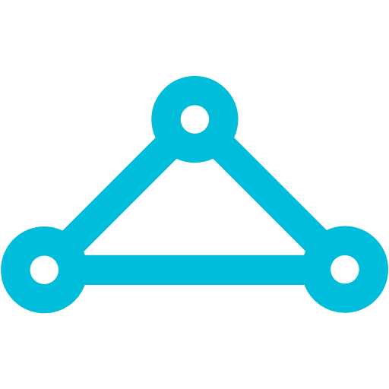

Microsoft Azure Services
Office Add-in
PC
Tablet
Phone
Browser
Games console
On-premises service
On-premises database
Client layer
(on-premises)
Access Control
Layer
AD
Multifactor
Authentication
BizTalk Services
Service Bus
CDN
Traffic Manager
Virtual Networks
Express Route
Integration
layer
API Mgmt
Mobile Services
Websites
Cloud Services
VM
Media Services
Notification Hubs
Scheduler
Automation
Application
layer
Blobs
Tables
Queues
SQL Database
Machine Learning
HD Insight
Caching
Backup and Recovery
StorSimple
Data Layer
Storage
Data
Notes:
Microsoft Azure provides many different types of services that can be used to build applications and other solutions. As you can see on this slide, they can be categorized into different functional buckets such as access control, integration, application hosting and communication, data and storage technologies.
Some of these building blocks will directly match up their equivalent on-premises versions, such as Websites and Virtual Machines. Others may be new to you such as Mobile Services, Notification Hubs, and Virtual Networks and Traffic Manager. While we won’t have time to dig into many of the services that are available, we will take a detailed look at a few key ones as we demonstrate taking the Expenses solution to the cloud.

Slide 13
Virtual Machines
Getting started
Select image and VM size
New disk persisted in storage
Management portal
Windows Server
Boot VM from new disk
>_
Linux
Scripting
(Windows, Linux and Mac)
Blob Storage
Extra Small
Small
Medium
Large
X-Large
REST API
Cloud
Comprehensive
Networking
Notes:
It’s easy to provision new virtual machines in Azure using the management portal, via scripting in PowerShell or the Cross-Platform CLI (command line interface). All of these tools utilize a central REST API, so therefore you can also write your own code to work with virtual machines if needed. Virtual machines can be provisioned to run with the desired compute and memory resources needed for the workload, scaled up, and connected together with a virtual network.
You can either create your own virtual machines on-premises and then upload them and host in Azure, or you can use one of many different images that are already made available by Microsoft and third parties on Azure. Some of the images available on Azure already have commonly used application and framework stacks installed on them such as SQL Server, Oracle Database server, BizTalk Server, JDK, SharePoint, and so on. You can also run Linux in Azure, and you can find various distribution images already available such as SUSE, CentOS, Ubuntu, and more.

Slide 14
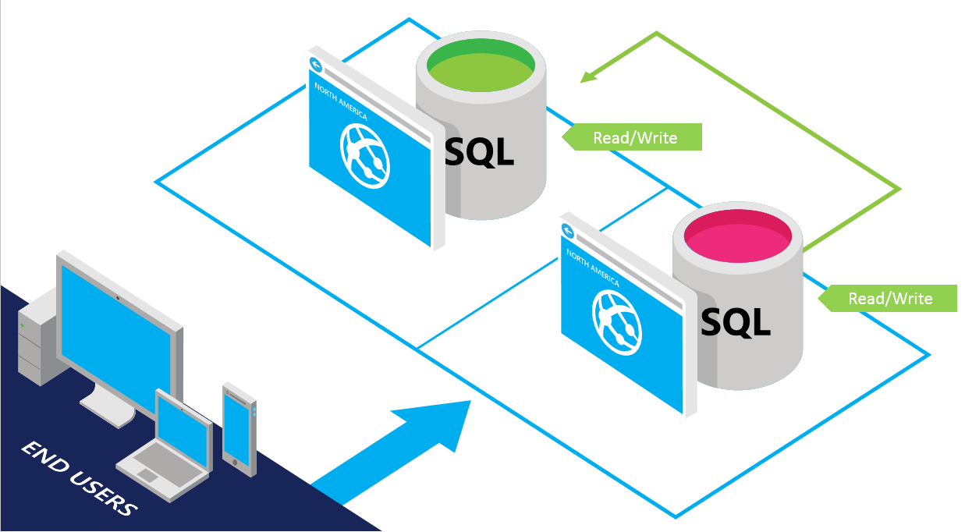
Azure SQL Database
SQL Server database technology as a service
Fully Managed service
Enterprise-ready with automatic support for HA
Designed to scale out elastically with demand
Ideal for simple and complex applications
Full support for TDS and ODBC
Familiar language and framework support
Cross Datacenter failover and backups to support disaster recovery scenarios
Notes:
Microsoft Azure SQL Database is a relational database-as-a-service that delivers predictable performance, scalability, business continuity, data protection, and near-zero administration to cloud developers and solution architects. There are a number of different pricing tiers to choose from that provide differing levels of performance.

Slide 15



Microsoft Azure Web Sites
Start simple
Code smart
Go live
Create new sites in seconds
Easily manage and scale your sites
Automatic load balancing and shared storage across instances
Scale out or up to reserved instances for improved performance and scale
Built-in web jobs support
Use ASP.NET, ASP, PHP, Java or Node.js
SQL Azure or MySQL databases
Start with open source apps and frameworks
Develop with VS and WebMatrix
Supports any Web development tool on any platform (Windows, OSX, Linux)
Rapid deployment for quick iteration
Integrated source control with Team Foundation Server (TFS) and Git
Built-in monitoring of perf and usage data
Quick access to request logs, failed requests diagnostics and diagnostics
Notes:
Azure Websites is a fully managed Platform-as-a-Service (PaaS) that enables you to build, deploy and scale enterprise-grade web apps. Although our demonstrations will involve ASP.NET, WCF, and other Microsoft technologies, you can also use ASP.NET, Java, PHP, Node.js or Python for development. Connect to your data easily, whether it lives on SQL, MySQL, DocumentDB, MongoDB, Azure Table Storage, and so on. Hybrid Connections, Virtual Networks, Service Bus all make it easier to connect back to on-premises when needed.

Slide 16
Microsoft Azure Active Directory
Synchronize your corporate and 3rd party identities
Integration with O365
Support modern protocols
OAuth 2.0
OpenID Connect
WS-Fed
SAML 2.0
Identity and Access Mgmt Permissions
Users
Groups
Applications
Microsoft Azure AD
3rd party clouds/hosting
YOU
PCs and devices
Notes:
Azure Active Directory is a service that provides identity and access management capabilities in the cloud. In much the same way that Active Directory is a service made available to customers through the Windows Server operating system for on-premises identity management.
When you use Azure AD, it is Microsoft's responsibility to keep Active Directory running in the cloud with high scale, high availability, and integrated disaster recovery, while fully respecting your requirements for the privacy and security of your organization's information. You decide who your users are, what information to keep in the cloud, who can use the information or manage it, and what applications or services are allowed to access that information.

Slide 17
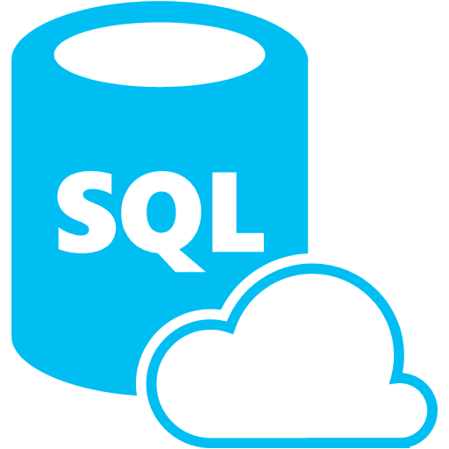


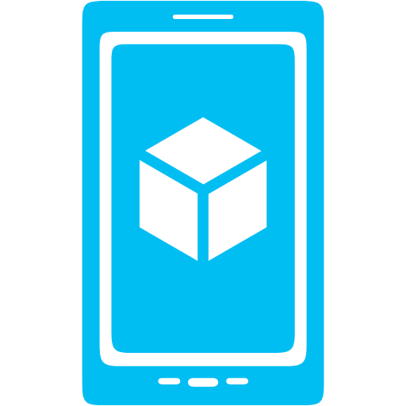


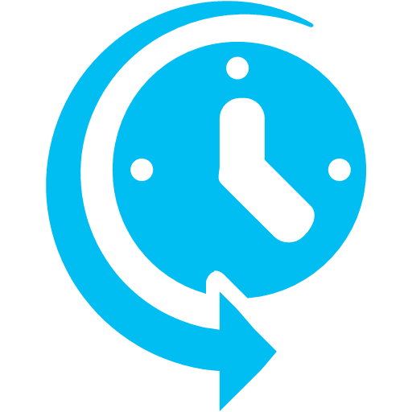
Mobile Services
Provides essential services to support client development
Client Support
iOS
Android
HTML5/Web
Xamarin
Windows
Windows Phone
PhoneGap
Sencha
Storage
Authentication
Logic
Push
Scheduler
Notes:
Azure Mobile Services is a Backend-as-a-Service
Instead of you having to design, build, test, deploy, manage, and upgrade your whole backend, we do it for you
Features of Mobile Services
Storage – SQL DB
Authentication – built in support for social providers w/ ability to custom auth
Backend logic – data validation, logical flows, etc
Push Notifications – across all major mobile platforms
Scheduler – backend job processing

Slide 18
Azure Portal
Notes:
Now we are going to take a tour of the new Azure management portal.

Slide 19
Expenses App Scenario Overview
Bret Stateham | Sr. Technical Evangelist
Christopher Harrison | Content Developer

Slide 20
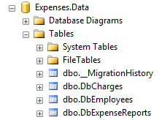
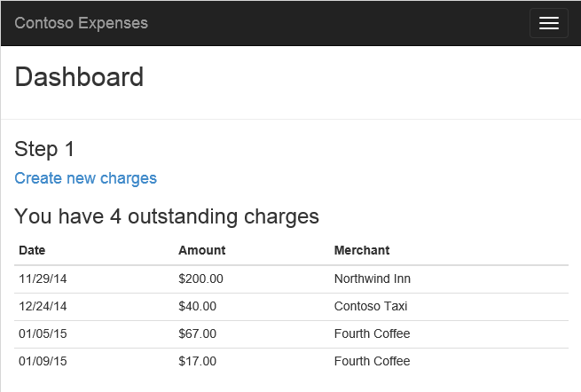
Expenses system
Corporate network
Expenses SQL DB
Expenses ASP.NET MVC application
Notes:
The Expense reporting application scenario that we will be using today consists of a couple different tiers including a SQL Database and an ASP.NET MVC client application. In our scenario, the entire system is currently deployed on-premises, but the engineering team has been charged with moving it to the cloud for a couple of reasons. The first reason is to offload some of the IT requirements and save some operational costs associated with running the application on-premises. Another is that the company is expanding across the country and has a growing workforce that needs to be able to use the system, and desires to be able to use it from many different devices including tablets and phones.

Slide 21
Expenses system

Slide 22
Azure migration lifecycle
Analysis
Data migration
Application migration
Optimization and testing
Operation and management
(or application first, depending on scenario)
Notes:
The migration life cycle is a standard methodology that provides you the step-by-step instructions for migrating your applications and data to the cloud. The main migration steps are Analysis Phase, Application Migration Phase, Data Migration Phase, Testing and Optimization Phase, and Operation and Management Phase.

Slide 23
Azure migration lifecycle
Analysis
Review existing architecture
Map with Windows Azure features
Data migration
Application migration
Optimization and testing
Operation and management
Notes:
The goal of this phase is to understand the business needs that require the solution. After identifying the business needs, review the existing application architecture to identify the main differences between on-premises solutions and cloud offerings to determine if you need to re-design the existing on-premises application. It’s entirely possible that you end up migrating pieces of your system to the cloud, rather than the entire application and all dependencies.
This analysis and planning phase should be completed with care as you not only have to account for feature differences for services offered by Azure, but also prepare a plan for performance and scalability, plan for life cycle management.

Slide 24
Azure migration lifecycle
Analysis
Data migration
Move relational data to SQL Database
Move non-relational data to Azure Tables, Blobs, Files
Application migration
Optimization and testing
Operation and management
Notes:
At a very high level, move your relational data from on-premises SQL Server to SQL Database running as a service (or virtual machine) and move unstructured data to storage like Blob, Table, or Drives.

Slide 25
Azure migration lifecycle
Analysis
Data migration
Application migration
Connect to data in Azure
Implement changes required for Azure (if any)
Optimization and testing
Operation and management
Notes:
Many on-premises applications can run in Azure with very minimal or no changes necessary, but it would be wise to start with a proof-of-concept version of the application using test data. Then evaluate any performance, scalability, and security problems and iterate.

Slide 26
Azure migration lifecycle
Analysis
Data migration
Application migration
Optimization and testing
Functional testing
Load testing
Operation and management
Notes:
After you migrate your application and data to Azure, perform functional and performance tests. At this phase, test your application in the cloud and confirm that it works as expected. Then, compare performance results between on-premises and Azure. After that, resolve any feature, functionality, performance, or scalability issues in your cloud application.

Slide 27
Azure migration lifecycle
Analysis
Data migration
Application migration
Optimization and testing
Operation and management
Monitor application performance
Manage data recovery plan
Notes:
After the testing and optimization phase, set up and implement application monitoring and tracing with Diagnostics. Diagnostics enables you to collect diagnostic data from an application running in Azure. You can use diagnostic data for debugging and troubleshooting, measuring performance, monitoring resource usage, traffic analysis and capacity planning, and auditing.

